Slide 1
Notes:
SAWS PE

Slide 2
Meeting Agenda
Oral Statements
Pre-Bid Meeting
Contract Requirements
SMWVB
Change Request
Bid Packet Preparation
Additional Reminders
Communication
Key Dates
Contract Reminders
Project Overview
Required Experience
Coordination
Contract Requirements
  Special Provisions
  Special Specifications
  Supplemental Conditions
  Special Conditions
Notes:
SAWS PE

Slide 3
Oral Statements
Oral statements or discussion during the pre-bid meeting will not be binding, nor will it change or affect the terms or conditions within the Plans and Specifications for this Project. Changes, if any, will be addressed only via an Addendum.
Notes:
SAWS PE

Slide 4
Pre-Bid Meeting
Non-mandatory pre-bid meeting
Attendees should sign-in via chat on WebEx and sign-in sheet will be posted on SAWS website
Key project information:
  Construction duration is 270 calendar days
  Construction estimate $3,452,955.00
  Construction services being procured through Invitation for Bid (low bid) under Texas Government Code 2269
Notes:
Contracting

Slide 5
Contract Requirements
  Prevailing Wage Rate and Labor Standards – Section 2.10 of the General Conditions
    Certified payroll to be submitted on weekly basis
    Wage decisions are included within the specifications
    Contractors to utilize LCP Tracker
    Site visits are random and unannounced
    Interviews will be conducted and will be private & confidential
    Payroll records are subject to review
    All apprenticeship programs will need to be approved by Department of Labor prior to starting
    Contractors are responsible for sub-contractor payroll
    Late payrolls delay contractor payments from SAWS
Notes:
Contracting

Slide 6
Contract Requirements (Continued)
Insurance requirements are found in Section 5.7 of the GCs
  Builder’s Risk coverage is waived and construction w/ Pollution, Installation Floater & XS 2 Million
  Maintain insurance coverage during the construction of this Project
Submittals and invoicing will be handled through CPMS
Notes:
Contracting

Slide 7
Aspirational SMWB Goal
Industry | Aspirational SMWB Goal
Construction | 20%
The aspirational SMWB goal is 20% of your total bid price.
Notes:
Contracting

Slide 8
Accepted SMWVB Certification Agency
South Central Texas Regional Certification Agency
  MBE, WBE, SBE (Includes “HUB” Program)
Minimum Qualifications for SMWVB recognition:
SBE-Certified (even MBEs and WBEs)
Local office or local equipment yard

Slide 9
Good Faith Effort Plan (GFEP) FAQs
Q: Is the 20% SMWB goal mandatory?
A: No, but we ask prime contractors to do their best with good faith outreach efforts. If the goal is not met, proof of outreach efforts is required with the submittal.
Q: What if I am having trouble finding SMWB subcontractors?
A: Please email the SMWVB Program Manager with the scopes of work you are seeking. You will receive lists of local SMWVB-certified firms to contact.
Q: What if my business is SMWB-certified? Do I need to find SMWB subs?
A: If your firm is SMWVB-certified, you will most likely meet the goal. However, the GFEP is a required document, and a good faith outreach effort is still necessary.
Q: Do I need to include all my subcontractors in the GFEP or just those that qualify towards the
SMWB goal?
A: All subcontractors need to be included in the GFEP, even those that may not count towards the SMWB goal.
Q: What if I have questions about the GFEP?
A: Please contact the SMWVB Program Manager at 210-233-3420, or at Marisol.Robles@saws.org . GFEP questions can be asked at any time before the submittal is due.
Notes:
SMWB

Slide 10
Post Award: Subcontractor Payment & Utilization Reporting (S.P.U.R.) System
1. Subcontractor & Supplier Payment Tracking
2. Subcontractor and Supplier Additions or Substitutions
3. LCP Tracker
4. Must be Current and Accurate before Retainage is released https://saws.smwbe.com

Slide 11
Bid Packet Preparation
Utilize and submit the Bid Packet Checklist with all required items
Statement of Bidder’s Experience be completed and included instead of list of projects and resumes (use revised version issued with Addendum 2)
Double check all mathematical calculations and verify all extensions
Ensure Mobilization and Preparation of ROW do not exceed the allowed percentages (10% and 5%) respectively
References and contact information should be verified prior to submitting a Bid
Addendums are acknowledged on the Bid Proposals Signature Page
Detailed baseline schedule (using NTP of July 20, 2020 per Addendum 2)
Notes:
Contracting

Slide 12
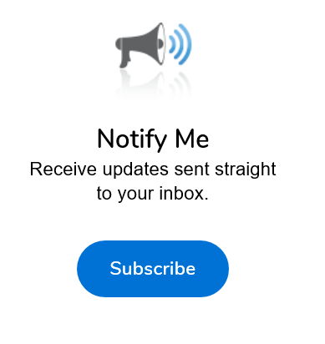
Additional Reminders
Register with Vendor Registration Program on the SAWS website at www.saws.org to ensure access to the latest information.
To receive updates on specific projects, registered vendors should subscribe to the project by selecting the project, and clicking ‘Subscribe’ under the Notify Me box.
Notes:
Contracting

Slide 13
Communication Reminders
There should not be any communication with the following:
  Design Engineer (Merrick)
  SAWS Project Manager or Project Engineer
  Any other SAWS staff
  City Council member or staff
  SAWS Board of Trustees
This includes phone calls, emails, letters, or any direct or indirect discussion of the Bid.
Notes:
Contracting

Slide 14
Key Dates
May 11, 2020 by 4:00 PM Questions Due
May 18, 2020 by 4:00 PM Addendum Posted to SAWS Website
May 28, 2020 by 2:00 PM Bid Proposals Due
June 2020 Responsible Bidder Evaluation
June 2020 Selected Contractor Notified
*July 7, 2020 SAWS Board Approval and Award
Week of July 20, 2020 NTP Issued
*SAWS intends to expedite execution of this contract. Bidder will be expected to provide signed contract, performance and payment bonds and insurance within days of the bid opening.
Notes:
Contracting

Slide 15
Key Dates - Submission Due Date
Bids are due no later than
2:00 PM CT Thursday, May 28, 2020
Follow specific delivery instructions:
  Deliver to 2800 U.S. Highway 281 North, Customer Service Building, Counter Services
  Make arrangements if mailing a bid
  Late responses will not be accepted and will be returned unopened
  Due to the COVID 19 situation, it is likely that SAWS will accept bids electronically, SAWS will modify instructions for the bid opening via a future Addendum
Notes:
Contracting

Slide 16
Contract Reminders
Contractors must include a “Baseline Construction Schedule” (CPM method) with the Bid Proposal and acknowledged in the Bid Packet Checklist.
Submittals can be submitted as soon as receiving notification of contract award after CPMS training (if necessary) has been completed.
Anticipated NTP week of July 20, 2020
Notes:
Contracting

Slide 17
Site Locations

Slide 18
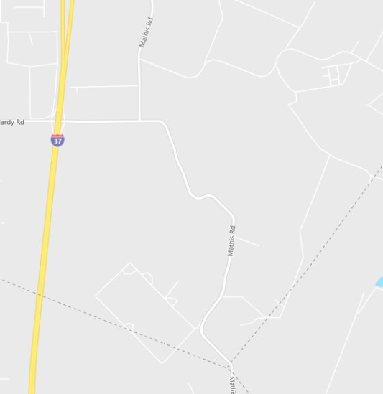
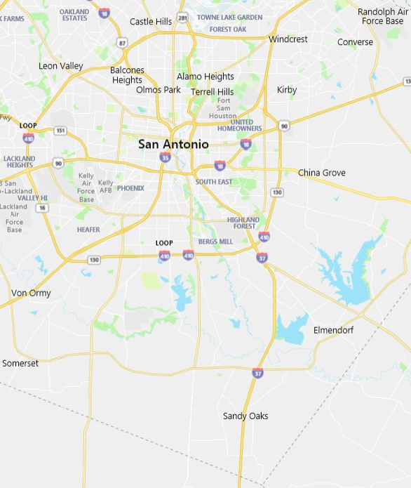
Project Overview - Map
Project Area
Project Area
Notes:
Consultant

Slide 19
Project Overview
Two well sites:
  Test Well (TW)-1
    Previous test well site, being converted to production well
    Demo of existing facilities (Except casing and wellhead)
  Brackish Groundwater Desalination (BGD)-14
    Newly developed well site
  Both Sites
    Construction of pumps, piping & valves
    Site improvements including fencing, paved drives, flush ponds, fences and electrical building
    Associated electrical power, instrumentation, controls and communications
Notes:
Consultant

Slide 20
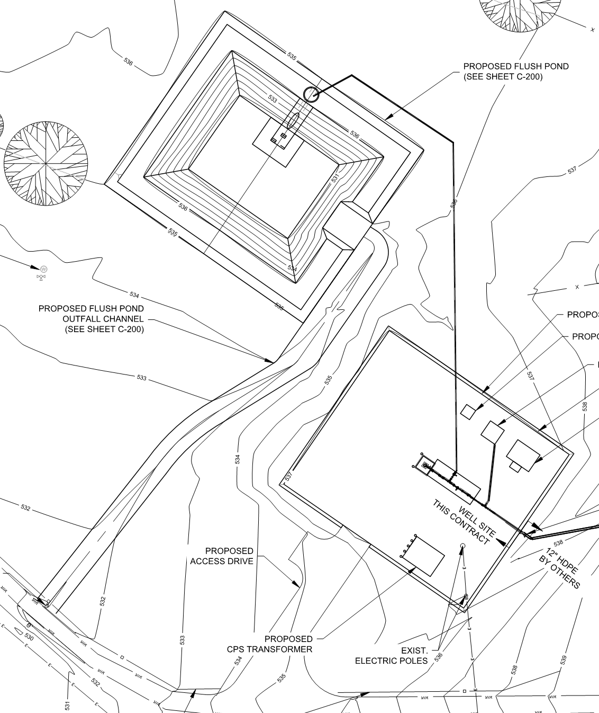
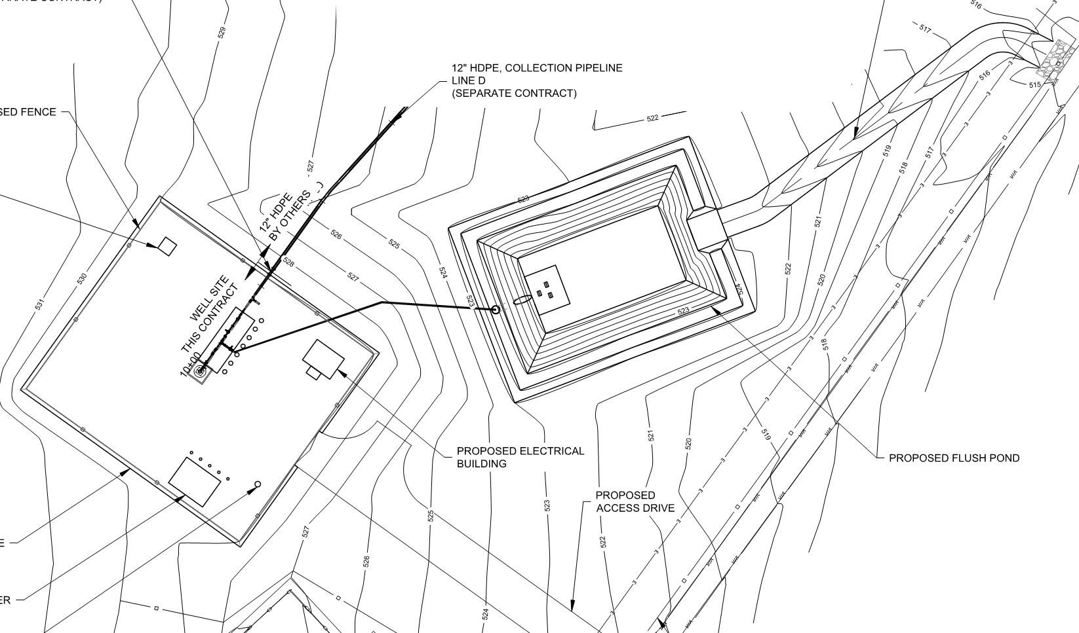
Project Overview (Continued)
TW -1
BGD - 14
Notes:
Consultant

Slide 21
Required Experience
Construction of new well site equipment including installation of well pump; piping and valves; site improvements including concrete work, flush ponds, fencing, and paving; electrical power, instrumentation, and communication equipment
Detailed requirements are included in the Statement of Bidder’s Experience, which must be completed by the contractor
Notes:
Contracting

Slide 22
Coordination
SAWS Operations
  Site Access & Security Clearance
  Existing Site Access
Pipeline Contractor (separate contract)
CPS Energy
Notes:
Consultant

Slide 23
Contract Requirements – Supplemental Conditions
Key Supplemental Conditions
Baseline Schedule & Experience w/ Bid
Pre and Post-Construction videos
Liquidated Damages of $1,250.00 per day
Notes:
Consultant

Slide 24
Contract Requirements – Special Conditions
Key Special Conditions
Geotechnical information available for review and is posted on SAWS website for download upon the completion of a disclaimer form
Notes:
Consultant

Slide 25
SMWVB Questions
Questions related to SMWVB may be directed to SAWS’ SMWVB Program Manager until bids are due. Her contact information is as follows:
  Marisol V. Robles
  Contract Administration Department
  San Antonio Water System
  Email Address: Marisol.Robles@saws.org
  Telephone No.: (210) 233-3420
Notes:
Contracting

Slide 26
Questions
Should be submitted no later than May 11, 2020 at 4:00 PM CDT.
Must be submitted in writing:
  Roxanne L. Lockhart
  Contract Administrator
  Contract Administration Department
  San Antonio Water System
  Roxanne.Lockhart@saws.org
  Fax: (210) 233-4438
Notes:
Contracting

Slide 27
Notes:
Contracting

